Slide 1

Data Science Salaries
Notes:
2020-2023
Various countries and job titles

Slide 2
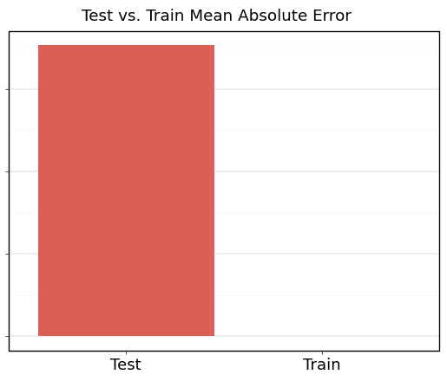
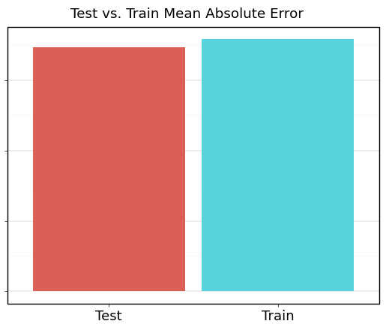
Does the mean absolute error improve by much when applying LASSO on all predictors when comparing it to a model without applying it?
Pre-LASSO model has extreme overfitting.
Post-LASSO removed overfitting, but still relatively high MAE.
Overall model performance not great, but applying LASSO certainly helps.
Pre-LASSO
Post-LASSO
Notes:
Linear Regression model as basis for comparison
Pre-LASSO model has test MAE in the trillions
Pre-LASSO train MAE and Post-LASSO train and test MAE in 30,000s

Slide 3
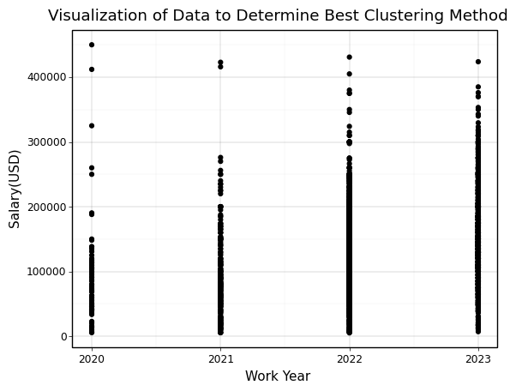
Looking at work_year and salary(in USD), what type of clusters are formed and what kind of relationship is there between them?
Initial scatterplot made to determine best clustering method.
Data didn’t have much variation
Notes:
Wasn’t a lot of data variation to work with, remote_ratio only 0-50-100
Obvious clusters

Slide 4
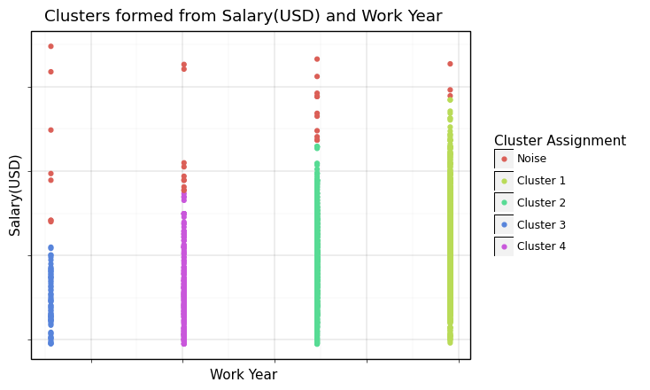
DBSCAN Chosen for the Clustering Method
Each cluster represents the salary for respective year.
Outliers displayed to give a more general idea of what salary to expect.
Overall trend in salary growth is linear and moderately high.
Notes:
- Steady salary growth, more demand?

Slide 5
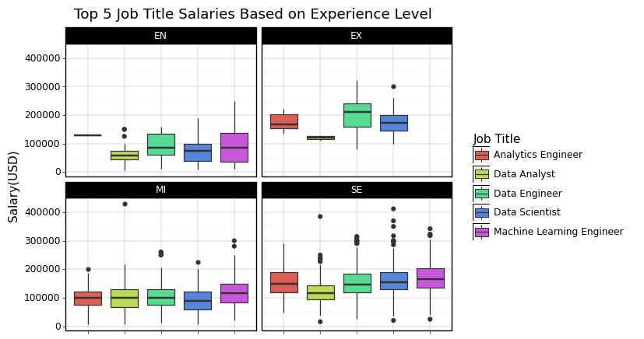
Of the top 5 common job titles, based on the experience level, which jobs typically have a salary amount of greater than 100,000(in USD)? What kind of relationship is there? Is there a different relationship when basing it on company size?
Most jobs make an average of roughly 100k if non-entry level.
Analytics Engineer only job that makes 100k or above across all levels.
Data Engineer and Machine Learning Engineer typically have highest earnings.
Data Analyst typically on lower end of salary earnings.

Slide 6
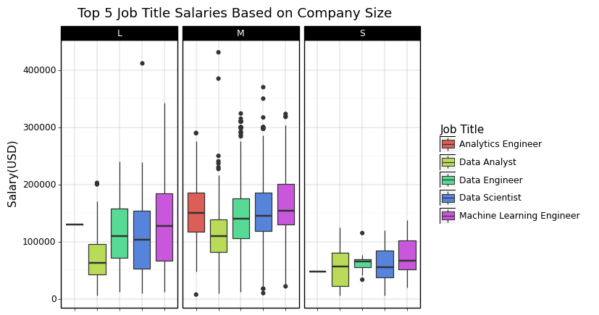
Based on Company Size Instead of Experience Level
Similar trends remain for certain job titles.
Interestingly, medium sized companies pay more than larger companies.
All job titles at medium sized companies make an average of above 100k or more.

